Slide 1

Sales Insight Prediction: Forecasting Future Sales Using Data Mining and Data Warehousing
Name: K. A. N. N. Kodikara
INDEX NO: AS2021907
Course: ICT 333 1.5 – Data Mining & Data Warehousing

Slide 2


Introduction
Sales prediction helps businesses plan inventory, marketing, and operations.
This project uses historical sales data to identify trends, analyze categories, evaluate profit, segment customers, and forecast future sales.

Slide 3

Dataset Overview
DATASET: SAMPLE – SUPERSTORE DATASET (KAGGLE)
ROWS: 9,994 RECORDS
COLUMNS: 21 FEATURES
KEY COLUMNS INCLUDE:
ORDER DATE, SHIP DATE, CATEGORY, SUB-CATEGORY, REGION
SALES, PROFIT, QUANTITY, DISCOUNT
CUSTOMER ID, PRODUCT ID, SEGMENT

Slide 4

Categories and Sub-Categories
Main Categories:
Furniture
Office Supplies
Technology
Sub-Categories Examples:
Chairs, Tables, Binders, Phones, Accessories

Slide 5

Data Preprocessing
STEPS PERFORMED:
Converted Order Date, Ship Date to datetime.
Created new features:
Ship Duration = days between order and shipping
Profit Margin = Profit / Sales
Checked for missing values → none found in critical fields.

Slide 6

Exploratory Data Analysis
KEY INSIGHTS:
Sales peak in November and December.
Office Supplies and Furniture are top categories.
West and East regions have highest sales.
High discounts reduce profit.

Slide 7
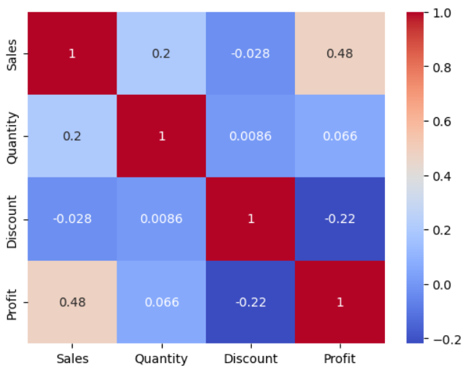
Correlation Heatmap
Shows relationships between numerical variables like Sales, Profit, Quantity, and Discount.
Positive correlations: Sales ↔ Profit, Quantity ↔ Sales.
Negative correlation: Discount ↔ Profit.

Slide 8
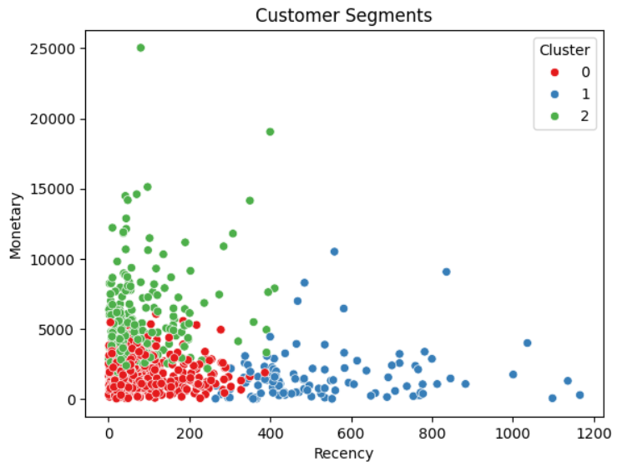
Customer Segmentation (K-Means)
Used Recency, Frequency, Monetary (RFM) features: Recency: Days since last order
Frequency: Number of orders
Monetary: Total spend
Applied K-Means clustering → 3 clusters identified:
Cluster 0: High-value
Cluster 1: Mid-value
Cluster 2: Low-value

Slide 9
Predictive Modeling
Models built:
Linear Regression
Random Forest Regression
Features used: Quantity, Discount, Profit, Ship Duration
Model Results:
Model | R² | MAE | MSE
Linear Regression | 0.37 | 218.16 | 186,794
Random Forest | 0.77 | 92.54 | 68,586

Slide 10

Association Rule Mining
Tried Apriori algorithm for product association.
No significant rules found due to sparse co-purchases.

Slide 11
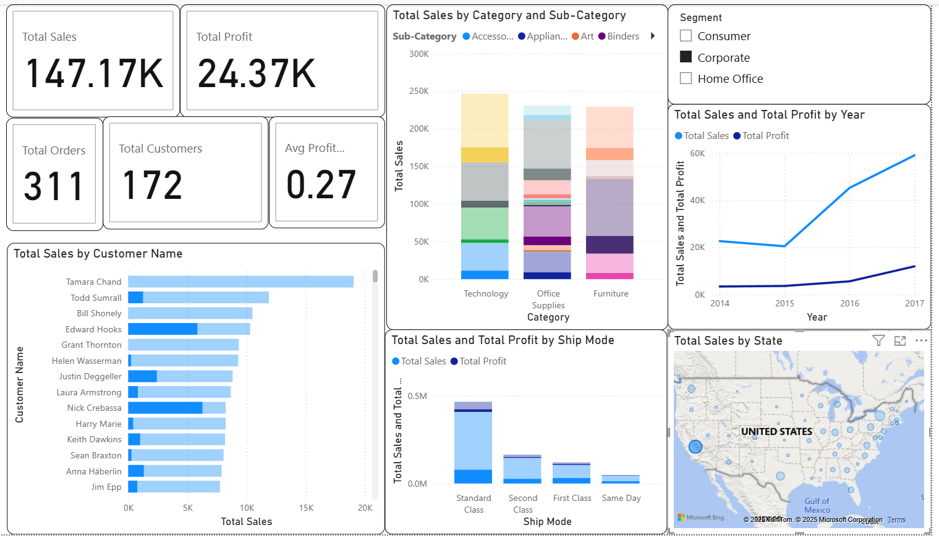
Dashboard Overview
Built interactive dashboard in Power BI showing:
Sales Trend
Sales by Category & Region
Discount vs Profit
Customer Segments

Slide 12
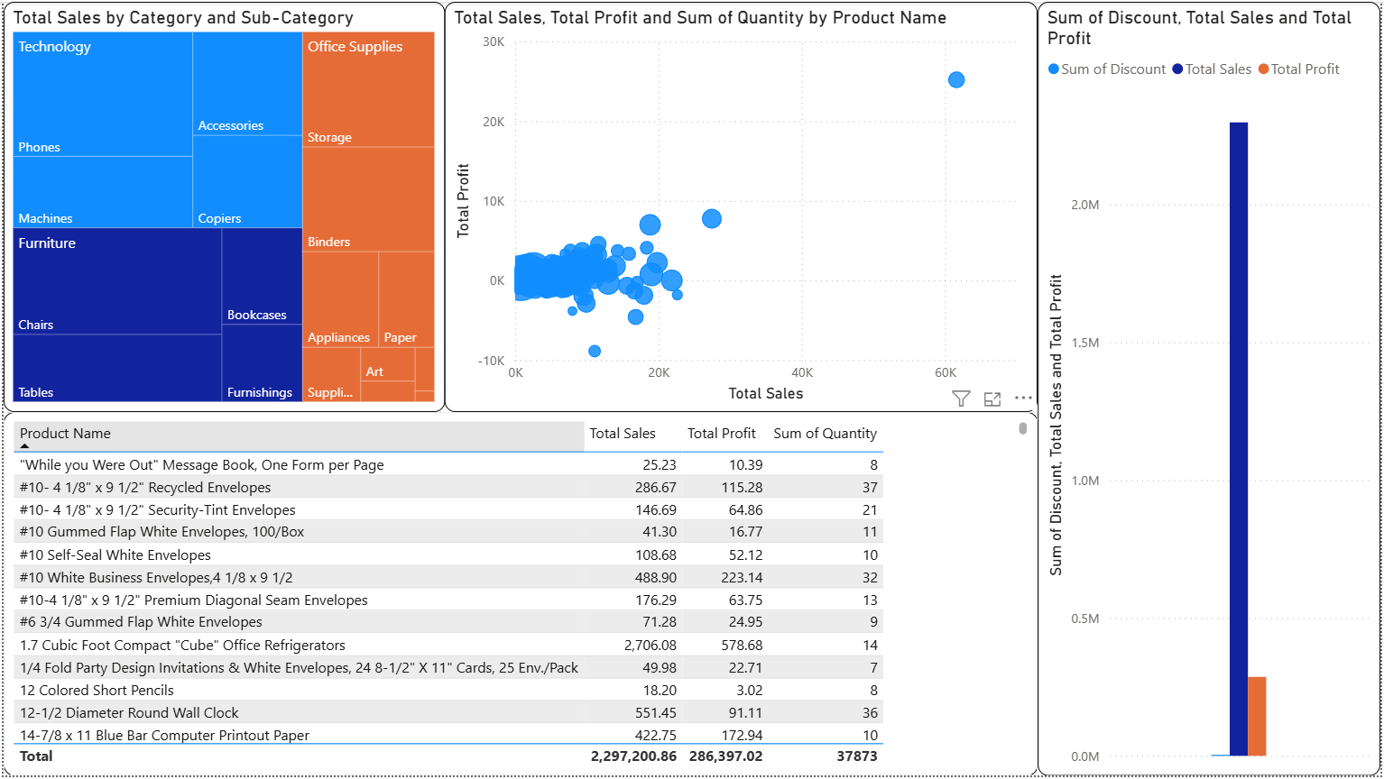
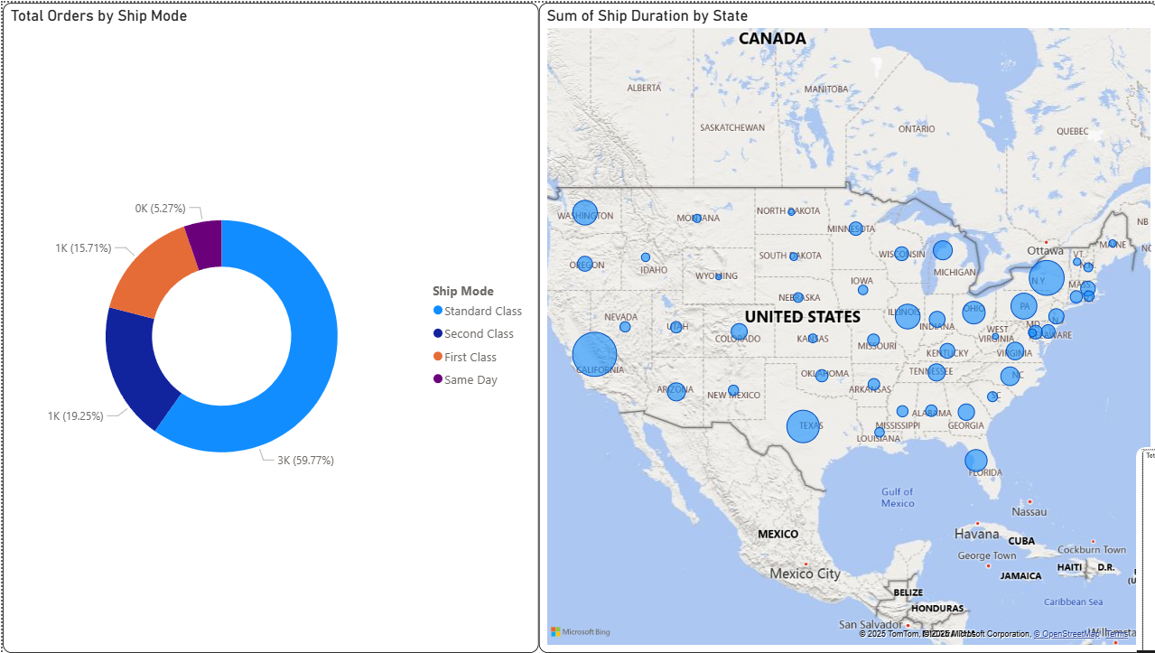
PRODUCT PERFORMANCE
SHIPPING OPERATIONS

Slide 13
Recommendations
Reduce over-discounting in low-profit categories.
Focus inventory and marketing on Office Supplies and furniture.
Target mid-value customers (Cluster 1) for promotions.
Use Random Forest for future sales forecasting.

Slide 14

Conclusion
Successfully analyzed sales data.
Segmented customers into actionable groups.
Built predictive models with reliable accuracy.
Created an interactive dashboard for insights.

Slide 15

THANK YOU ! Any questions?

